Slide 1
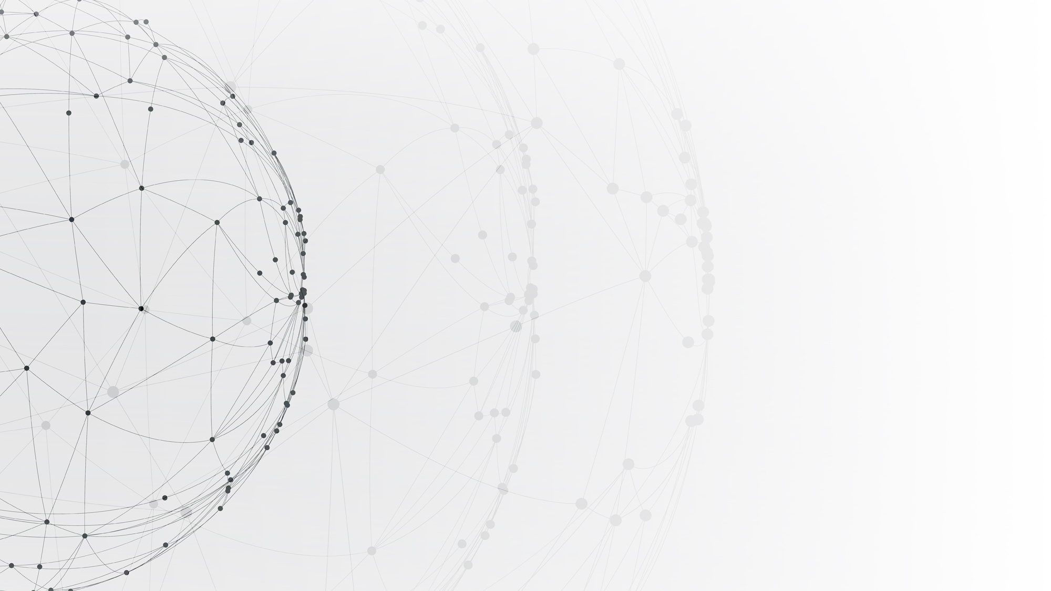
Federated Learning on non-IID data
HKU COMP4805 Project
Name: Wong Ngai Sum
UID: 3035380875
Notes:
Hello, I am Wong Ngai Sum and my project topic is Federated Learning on non-IID data.

Slide 2
01
Background
CONTENTS
02
Project brief
03
Experiments and Results
04
Summary
Notes:
These are the key parts of the presentation. I will first talk about the background of the project and the need for evaluation and some simple experiments to show or prove the situation. And I will end with a discussion of my findings, lesson learned and some limitation.

Slide 3
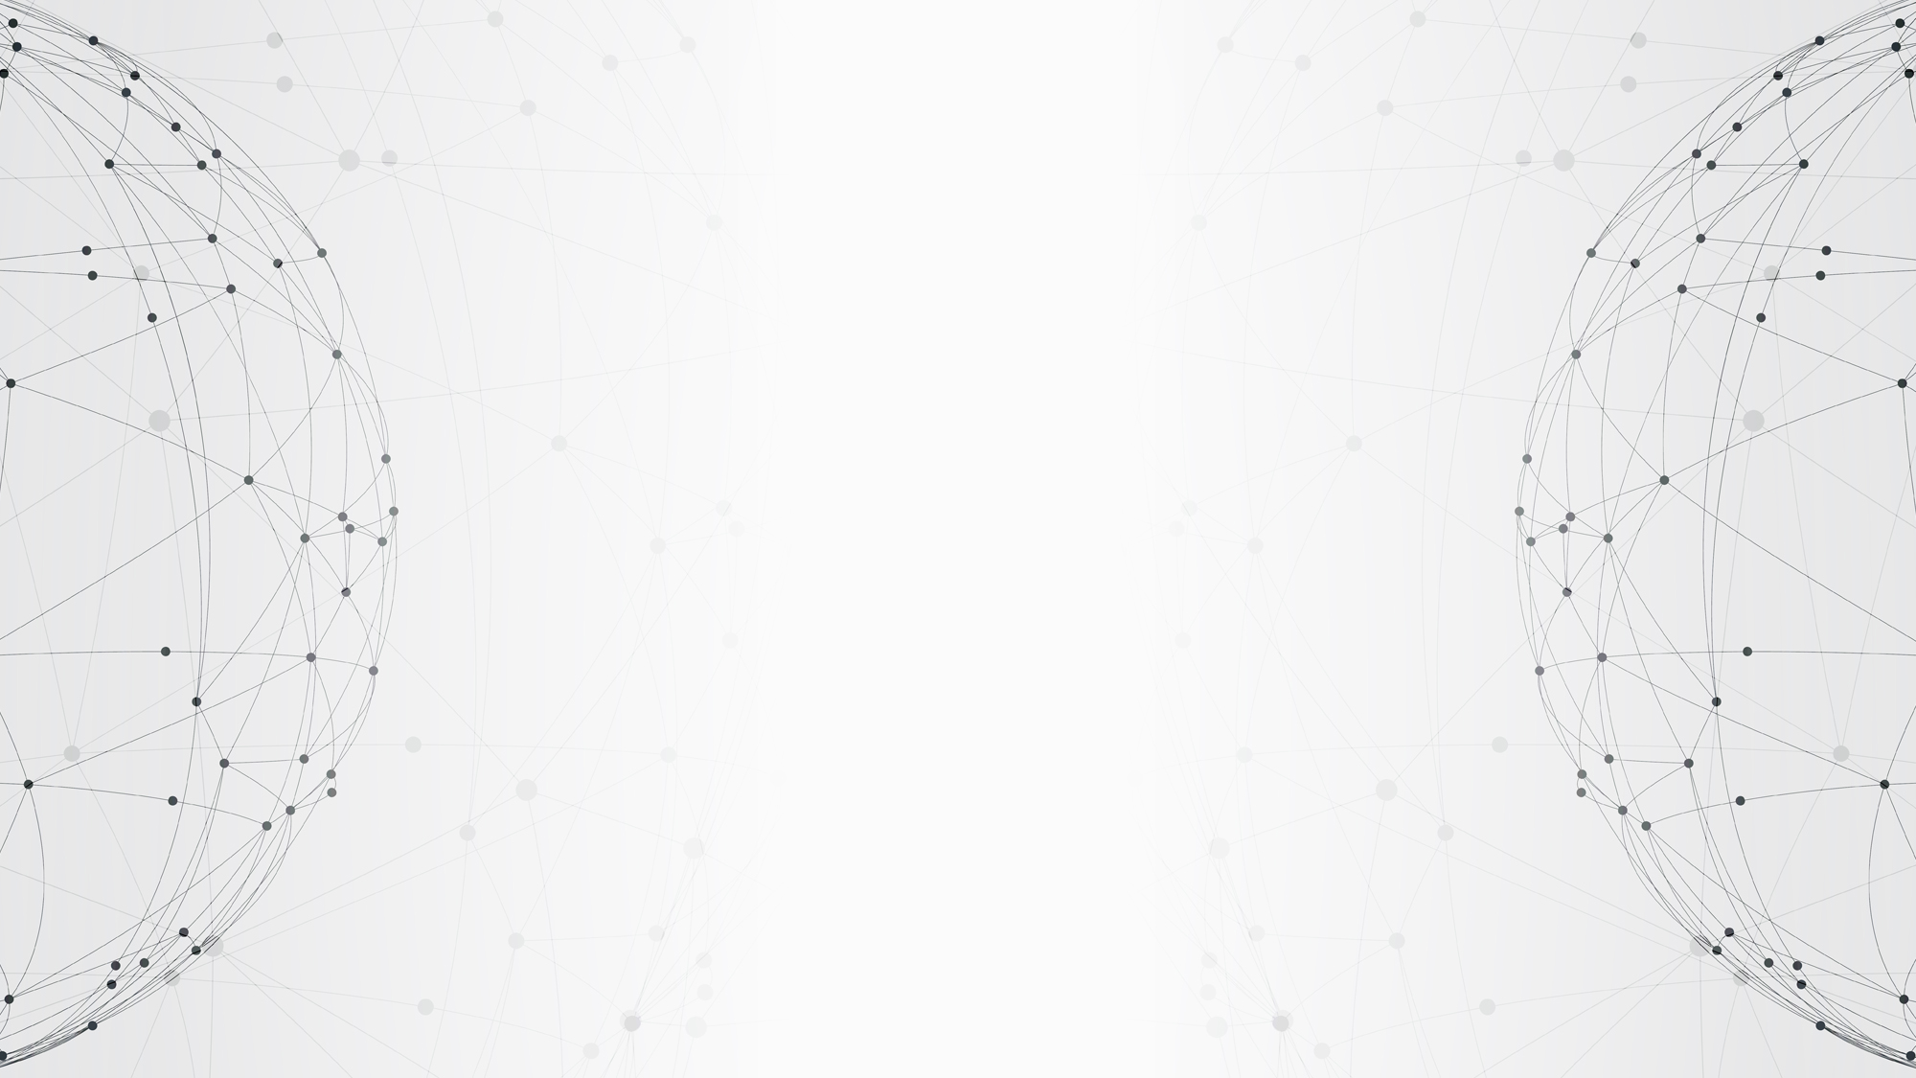
01
PART
Background
Notes:
I will start off by providing background of Federated Learning with non-IID data, which will show the need for a study and evaluation.

Slide 4
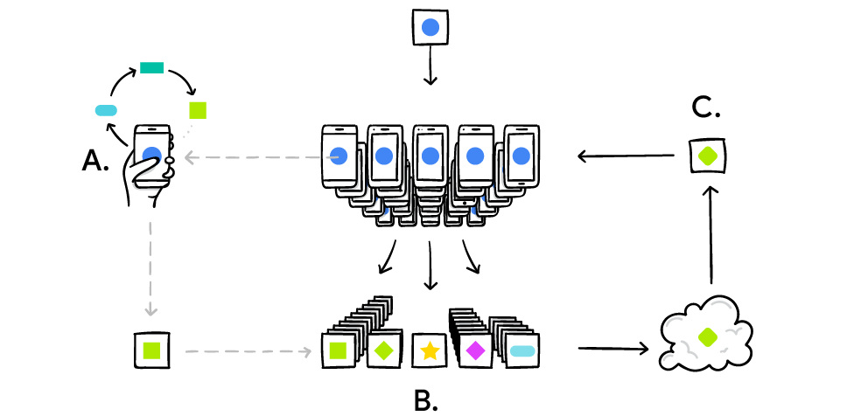
What is Federated Learning?
Benefits
Reduce privacy and security risks
Endure limited internet connection
Provide personalized model to clients
Downsides
Serious communication overhead
Suffer from privacy attacks
Low accuracy on non-IID data
A
Download
B
Improve
C
Upload
Your device downloads the current model.
Your device improves it by learning from local data.
Update to the model is sent to the cloud to improve the shared machine learning model.
Notes:
So nowadays smartphones and IoT devices are everywhere and a large amount of data are being collected through sensors for analytics. They generate enormous valuable data and machine learning is applied to those data to improve the intelligence of services. Standard machine learning requires operations in data centers with a centralized dataset to attain fast processing and low latency for transmission. However, it comes with several constraints such as data privacy and the inability to process large dataset. Serverless architecture and distributed architecture have become ways for many developers to have more flexibility and improve their services. ​Federated Learning​, a new decentralized AI framework presented by Google scholars, enables IoT and mobile devices to collaboratively learn a shared machine learning model, while reducing privacy and security risks, attaining lower latency and providing personalized models to clients. There are 3 steps in federated learning, download, improve and upload. First a device downloads the current machine learning model, then it will train the model using its local data and finally upload it to the cloud. The server will aggregate the updates and update the global model.

Slide 5
What is non-IID data?
1
IID data means independent and identically distributed data
2
Independent means the sample items are not connected in any way
non-IID
data
3
Identically distributed means all sample items are taken from the same probability distribution
4
Examples: smartwatch activities, medical data
Notes:
Alright, so how about non-IID data? First we need to know what is IID data. IID data means independent and identically distributed data. Independent means the sample items are not connected in any way. Identically distributed means all sample items are taken from the same probability distribution. Non-IID data is very common, such as smartwatch activities and medical data.

Slide 6
Problems of Federated Learning on non-IID data
1
Parameters divergence
2
Slow convergence / more communication rounds
3
Lower accuracy than in IID setting
4
FedAvg assumes data distribution
Notes:
Non-IID data noise is a common challenge in many disciplines including neuroscience. It may cause biased estimation in Federated Learning due to parameters’ divergence. Performance will be worse than in IID setting. Thus, convergence speed may be slow and it may even be impossible to converge to a useful model. Federated Averaging, the fundamental framework of federated learning, assumes data distribution of devices selected for training is same as the target distribution of the learning model, which is not the case in most situation, because data distribution on a device should be non-IID in most cases.

Slide 7
02
PART
Project brief
Notes:
Okay, so what is the purpose of this project?

Slide 8
Project brief
How different training settings, training parameters, models, optimizers affect performance
(related to FL and non-IID data?)
Performance analysis of FL with different non-IID data distribution
A comprehensive study of the phenomenon and related work
Explore the results from other research
Notes:
So, firstly, this project includes some performance analysis of Federated Learning on IID data and non-IID data, so as to understand the current situation of the problem. Then, I will test Federated Learning on non-IID data with different training setting, parameters, models and so on, to see the relationship between them and performance, and whether they are related to the problem. Also, after I did some experiments, I may compare them with other research to see if their claims are valid and my experiments are correctly-formed. I will not mention them in this presentation and will mainly focus on my findings. Finally, I can get a basic overview of the problem.

Slide 9
Roadmap
Literature review
(research related to FL and
non-IID data)
Analysis
(from empirical and
theoretical viewpoint)
Step 1
Step 2
Step 3
Step 4
Baseline research
(get familiar with Python,
basics of ML, ML framework…)
Experiments
(simulate FL using Pytorch)
Notes:
So how did I start working on this project? First I started by some baseline research, such as to get familiar with Python and ML, because I didn’t know how to program in Python and I didn’t take any AI and Machine Learning course. Then, I did some literature review, to see the current situation of the problem and how experiments on Federated Learning can be done. Then I did some basic experiments using Pytorch, an open source Machine Learning framework. Finally, I did some analysis on the results and make some empirical and theoretical explanations.

Slide 10
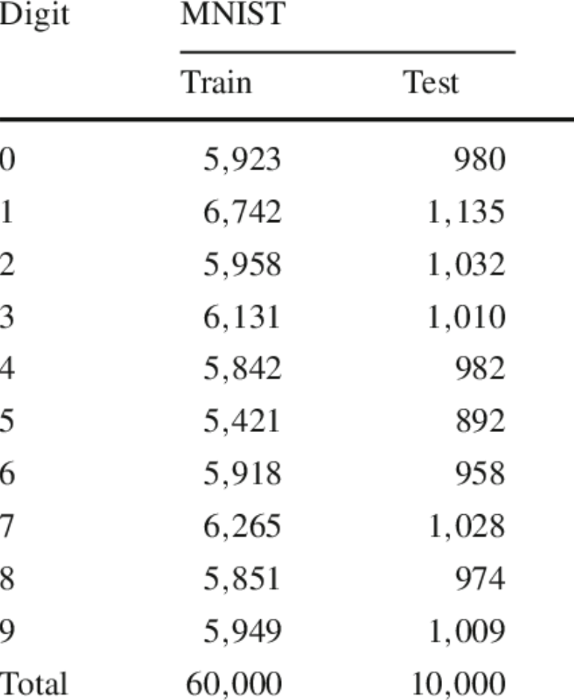
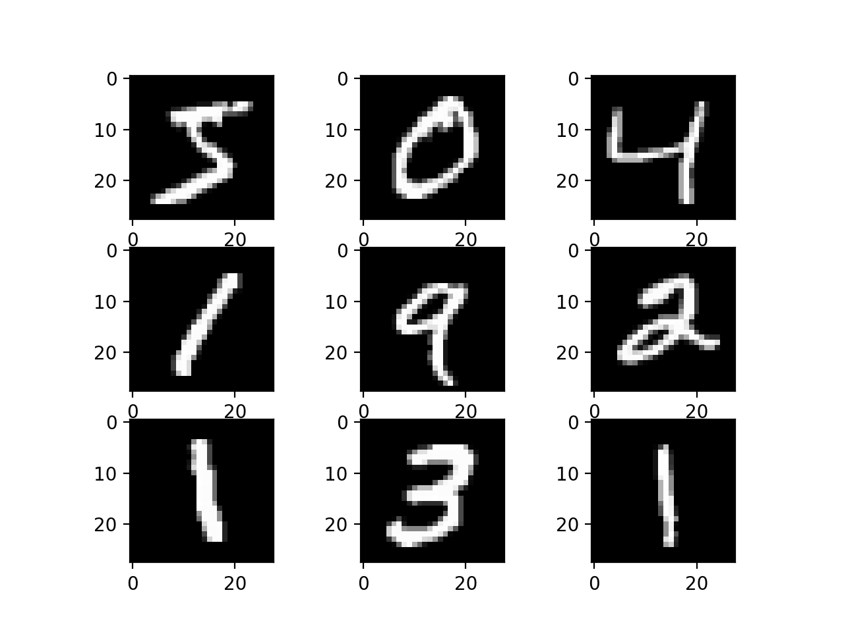
Datasets
1
MNIST
70000 28x28 images in 10 classes
60000 training images and 10000 test images
2
CIFAR-10
60000 32x32 color images in 10 classes
6000 images per class
50000 training images and 10000 test images
3
Use default train/test split
Notes:
So there are lots of real datasets available on the internet. I will use two famous datasets MNIST and CIFAR-10 for experiments. MNIST consists of black and white handwriting digits and CIFAR-10 consists of color images with 10 types of things. I will use default train and test split for simplicity.

Slide 11
Default training configurations
07
Manual random seed
01
Mini-batch size: 64
08
Loss function: log loss
02
Local epochs: 10
09
Number of devices: 100
03
Communication rounds: 50
10
Fraction of devices: 10%
CNN: 5-layer CNN (similar to LeNet)
04
Dataset: MNIST
11
05
Optimizer: vanilla SGD
12
FL algorithm: FedAvg
non-IID: 1/2/5 classes per device
06
Learning rate: 0.01
13
Notes:
And these are the training configurations of the experiments. Mini-batch size is 64, 10 local epochs on device, 50 communication rounds so we can observe the trend of performance, MNIST dataset as default so as to save time, vanilla SGD optimizer, 0.01 learning rate, cross-entropy loss function, manual random seed so results are reproducible, 100 devices and 10% of them will be selected at each round because devices may not be able to train model or connect to internet at a time, 5 layer CNN as model, which is similar to traditional LeNet, Federated Averaging as Federated Learning algorithm because it is the fundamental of Federated Learning. Regarding non-IID data distribution, I will test 1, 2, 5 classes per device, because they may be similar to real world situations.

Slide 12
Some other FL algorithms
1
FedProx:
provides a way for the server to account for the heterogeneity associated with partial information
2
FedCurv:
builds on ideas from Lifelong Learning, adapts the Elastic Weight Consolidation (EWC) algorithm from a sequential algorithm to a parallel one
This project focuses on FedAvg, which is the fundamental framework in Federated Learning setting
Notes:
So, regarding the problem of Federated Learning on non-IID data, some scholars suggested alternative Federated Learning algorithms, like FedProx, which provides a way for the server to account for the heterogeneity associated with partial information, with proved robustness and stability, and FedCurv, which builds on ideas from Lifelong Learning and adapts the Elastic Weight Consolidation algorithm from a sequential algorithm to a parallel one. These are too advanced for beginners like me, and I would like to focus on the fundamental structure of Federated Learning, so I would only use Federated Averaging in this project.

Slide 13
03
PART
Experiments and Results
Notes:
So lets see what experiments I did and the findings.

Slide 14
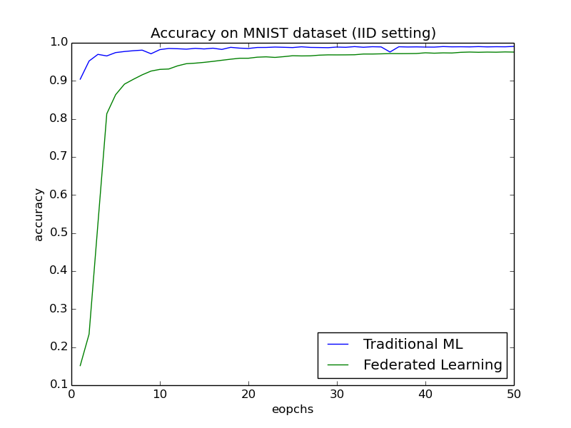
Traditional Machine Learning vs Federated Learning (IID)
1
Lagged convergence
2
Under-fitting after several rounds, slower learning
3
Not possible in most situations: only for comparison studies
Notes:
First lets see how tradition Machine Learning and Federated Learning perform on MNIST dataset in IID setting. No surprise, they both gain great performance. Tradition Machine Learning gains 99% accuracy after 10 epochs and Federated Learning gains 97.6% after 10 communication rounds. As we can see, Federated Learning converges slower than Traditional Machine Learning, through they get similar performance after several rounds. Then it becomes under-fitting, that’s why the learning speed becomes slower. Federated Learning with IID data is not possible in most situations so this is only for comparison studies.

Slide 15
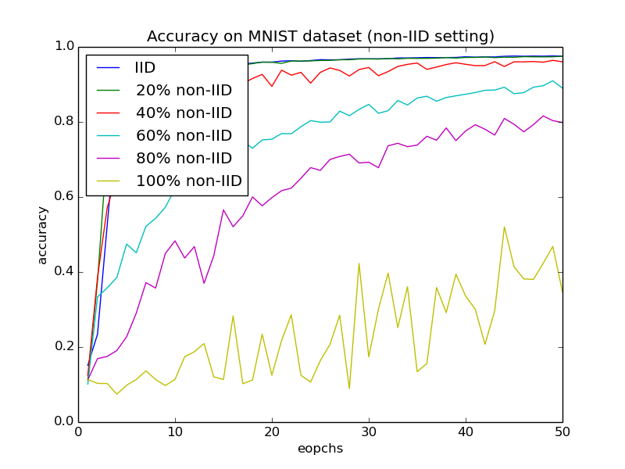
x% non-IID:
x% of data sorted by labels, remaining randomly distributed
Performance analysis of non-IID data
1
Slightly non-IID: can still reach high accuracy
2
Seriously non-IID: low and unstable accuracy, better than random guess
3
Unstable accuracy:
multiple devices have same class of data
Notes:
In this case, data distribution on devices are balanced. I will test the accuracy with percentage of non-IID. So x% of non-IID means x% of data is sorted by labels and distributed to device and remaining data is randomly distributed, or IID. We can see if it is 100% non-IID, accuracy is very low, only 34.6%, but if it is 80% non-IID, accuracy is 79.9%, 60%, accuracy is 89%, 40%, accuracy is 96%, 20%, accuracy is 97.5%. We can observe that of data distribution is slightly non-IID, we can still get good performance, but if it is seriously non-IID, we may get poor performance, but still better than random guess. But balanced data distribution may not be common.

Slide 16
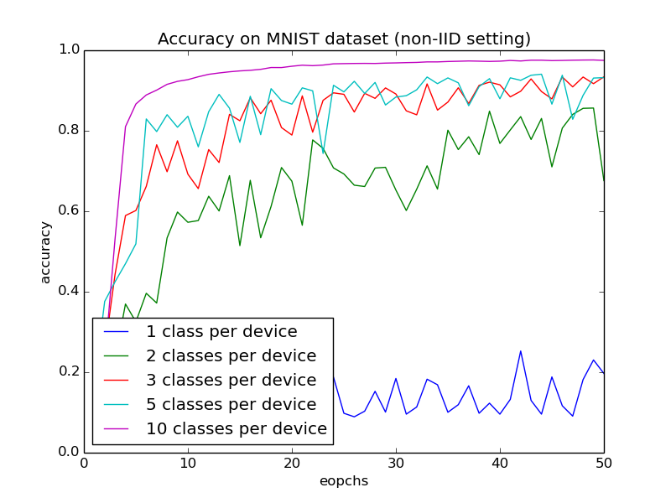
Performance analysis of non-IID data (unbalanced)
1
Slightly non-IID: can still reach high accuracy
2
Seriously non-IID: low and unstable accuracy
3
1 class per device < 100% non-IID?
Unbalanced data distribution
Notes:
In real life scenarios, data distributions are unbalanced and data from MNIST is a bit unbalanced. In this case, data distribution on devices are proportional to the distribution of MNIST. We can see if there is 1 class per device, accuracy is very low, only 19.7%, but if there are two classes, accuracy is 67.6%, three classes, accuracy is 93.4%, five classes, accuracy is 93.2%. As mentioned, 100% non-IID in balanced setting gets 34.6% accuracy, but in unbalanced setting accuracy becomes 19.7%, which reflects that unbalanced data distribution may be harmful to performance. Harm of unbalanced dataset is not obvious in IID setting, and is obvious when there is 1 class per device. So it is expected that if data is extremely unbalanced, performance will be very poor.

Slide 17
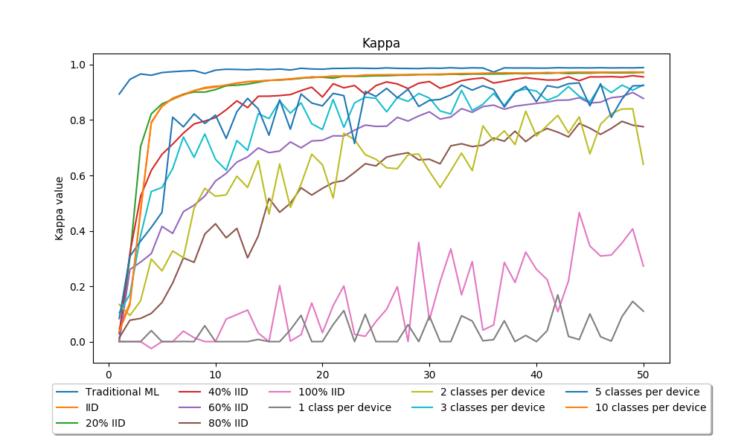
Performance analysis
1
Kappa is normalized at the baseline of random chance
2
When data is unbalanced, performance is worse
3
Seriously non-IID: seems random guess
Notes:
And I used Cohen’s Kappa to measure inter-rater agreement. It is normalized at the baseline of random chance. What it reveals is that when there is one class of data per device, no matter data distribution is balanced or unbalanced, performance is lagging behind others, and it seems the trained model is doing random guess.

Slide 18
Performance analysis
Number of rounds to achieve certain accuracies:
1
With slightly non-IID data distribution, can finally converge to a useful model, just a matter of time
 | 0.85 | 0.9 | 0.95
Traditional ML (in epochs) | 1 | 1 | 2
IID | 5 | 7 | 16
20% non-IID | 5 | 7 | 17
40% non-IID | 11 | 17 | 34
60% non-IID | 33 | 49 | 101
80% non-IID | 33 | 55 | 194
100% non-IID | ∞* | ∞* | ∞*
* Stopped checking after 200 rounds
Notes:
These are the number of rounds to achieve certain accuracies. It reveals that a model can finally converge to high accuracy with slightly non-IID data distribution. It is just a matter of time.

Slide 19
Performance analysis
Number of rounds to achieve certain accuracies:
1
With slightly non-IID data distribution, can finally converge to a useful model, just a matter of time
 | 0.85 | 0.9 | 0.95
Traditional ML (in epochs) | 1 | 1 | 2
IID | 5 | 7 | 16
1 class | ∞* | ∞* | ∞*
2 classes | 48 | 73 | ∞*
3 classes | 16 | 29 | 89
5 classes | 13 | 18 | 70
10 classes | 5 | 7 | 16
* Stopped checking after 200 rounds

Slide 20
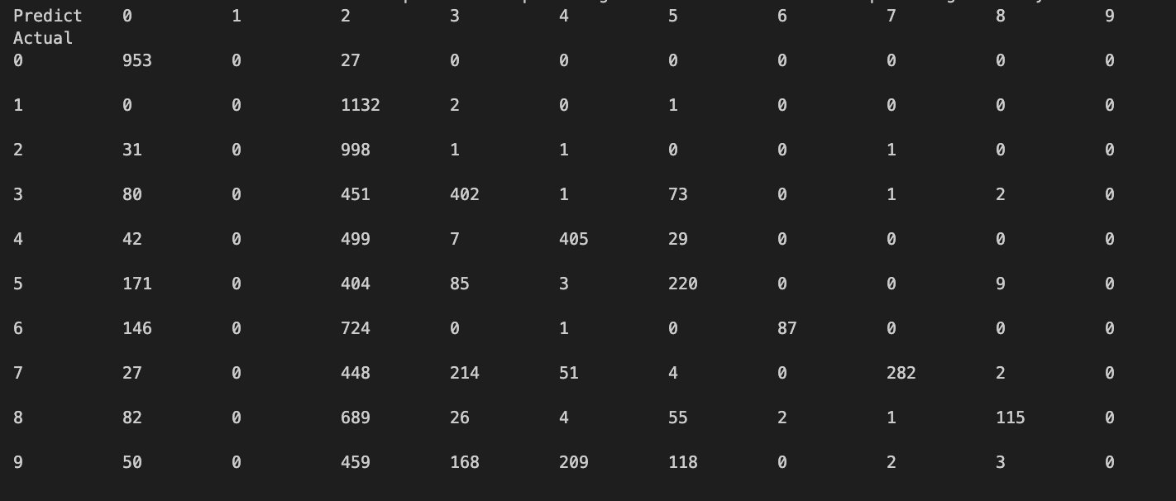
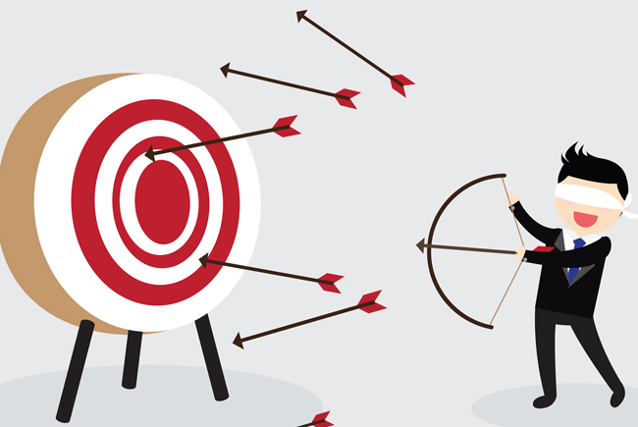
Predicted and target values in highly non-IID setting
100% non-IID in round 50: (34.6% accuracy)
1
Most predicted values are 0 and 2, where are 1 and 9?
2
During averaging models, precision may lose
Area under the ROC curve
0.95136 0.5 0.71407 0.67103 0.69124 0.60795 0.5453 0.63688 0.55815 0.5
Notes:
Yes of course, if level of non-IID is high, performance is poor. But I want to know what are the outputs of the model. Here are the predicted and target values of 100% non-IID in round 50. To conclude, most predicted values are 0 and 2, so where are 1 and 9? Of course, losses on training devices are low. But it shows that precision may lose during averaging models.

Slide 21
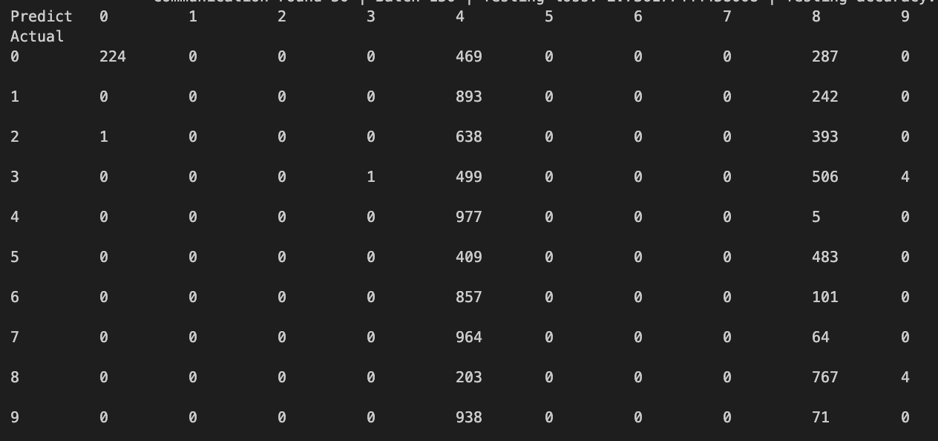
1
Most predicted values are 4 and 8, where are the others?
Predicted and target values in highly non-IID setting
1 class per device in round 50 (19.7% accuracy):
2
With unbalanced data distribution, worse performance, as models on some devices are not well-trained (close to the old model), averaging models make the situation worse
Area under the ROC curve
0.61423 0.5 0.5 0.5005 0.67199 0.5 0.5 0.5 0.77453 0.49956
Notes:
Here are the predicted and target values of 1 class per device in round 50. In this experiment, most predicted values are 4 and 8, where are the others? It reflects that with unbalanced data distribution, performance of trained model is worse, because models on some devices are not well-trained. Then the model on these devices are close to the old model, averaging models make the situation worse and convergence speed is substantially slower, especially in highly non-IID setting.

Slide 22
Why poor performance?
1
Systems heterogeneity
Highly non-IID: devices training different models
2
FedAvg is bad with non-IID
3
4
Poor training setting
Poor choice of training parameters
5
Notes:
So why performance is so poor? There are several obvious reasons, poor model, training setting, training parameters, systems heterogeneity, highly non-IID data distribution because devices may be training for local objectives, not for global objectives so they are training different models from target learning model. Also, Federated Averaging is bad with non-IID data distribution.

Slide 23
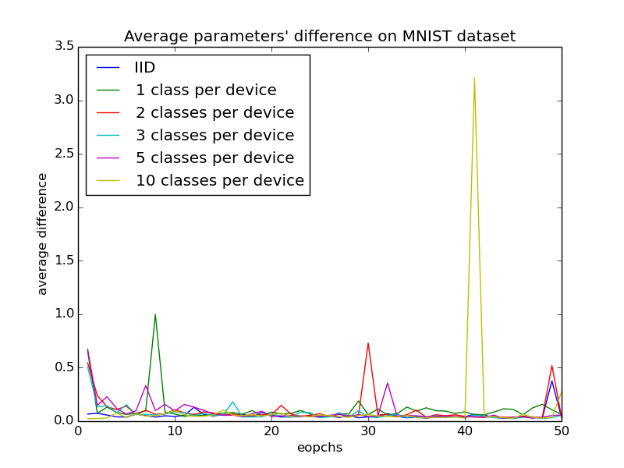
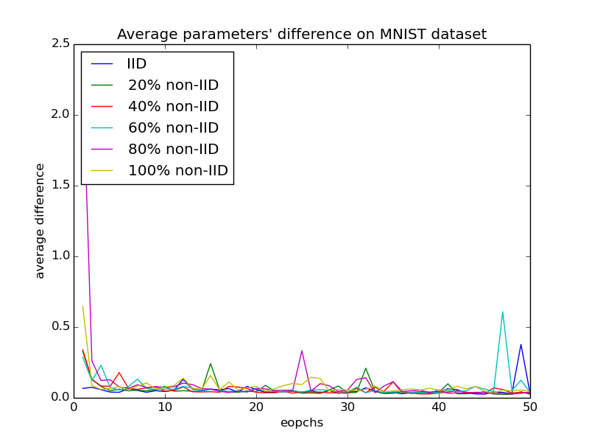
Parameters divergence on non-IID setting
Divergence is calculated by:
(Mean Absolute Percentage Error)
Notes:
So I want to see the parameters divergence in non-IID setting, which is calculated by mean absolute percentage error. It may not be a robust choice, but it does provide some insights.

Slide 24
Parameters divergence on non-IID setting
1
Poor accuracy & divergence similar?
Small changes in weight may result in a large change in the output
parameters can be +/-
Unbalanced distribution:
FedAvg based on uniform distribution
2
Notes:
It seems that divergence is bigger if it is non-IID data distribution. They are not quite obvious because small changes in weight may result in a large change in the output and the parameters can be positive or negative.

Slide 25
Parameters divergence on non-IID setting
3
Parameters change drastically
-> performance may change drastically
Notes:
Since Federated Averaging is based on uniform distribution, large parameters divergence on devices means the model they train are far away from target model, so performance may be poor.

Slide 26
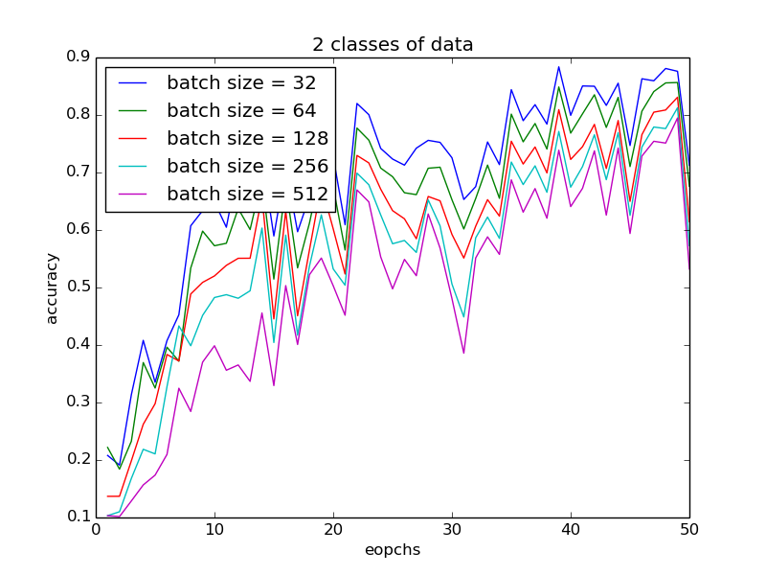
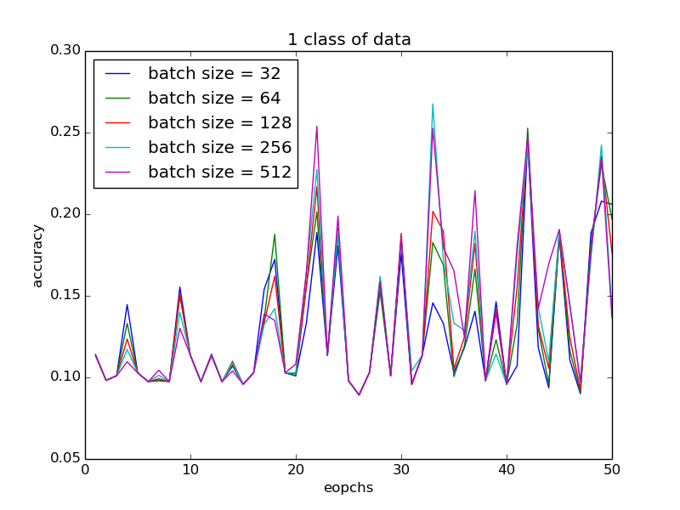
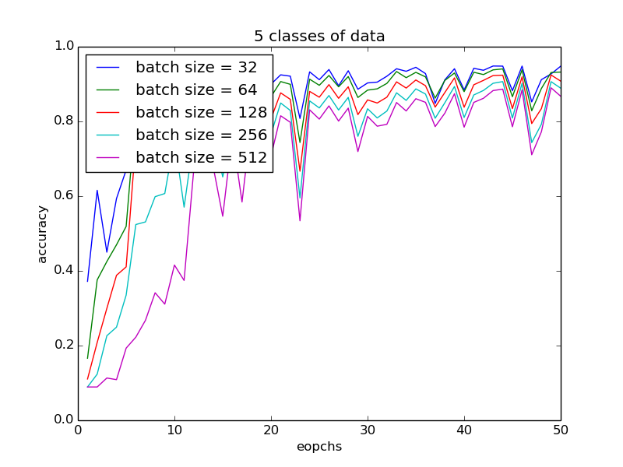
Mini-batch size
1
Batch size too large:
unstable accuracy
(sharp local minima)
Notes:
So I tested several mini-batch sizes to see how they affect performance. If batch size is too large, performance will be worse and unstable in this case because large batch lacks the explorative properties mini batch has and tends to zoom in on the minimizer closest to the initial point and may converge to sharp minimum, so general performance is poor.

Slide 27
Mini-batch size
2
More classes per device
-> batch size affects accuracy larger
Notes:
And if level of non-IID is high, then batch size may not be crucial. But if level of non-IID is low, batch size matters.

Slide 28
Mini-batch size
3
Optimal choice maybe related to of data on device, 32 in these 5 values
Notes:
And optimal choice maybe related to number of data on device, which is 32 in these five values.

Slide 29
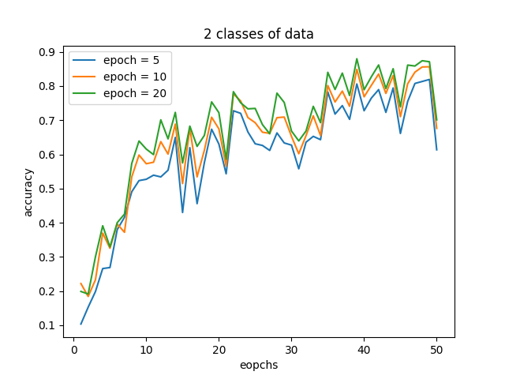
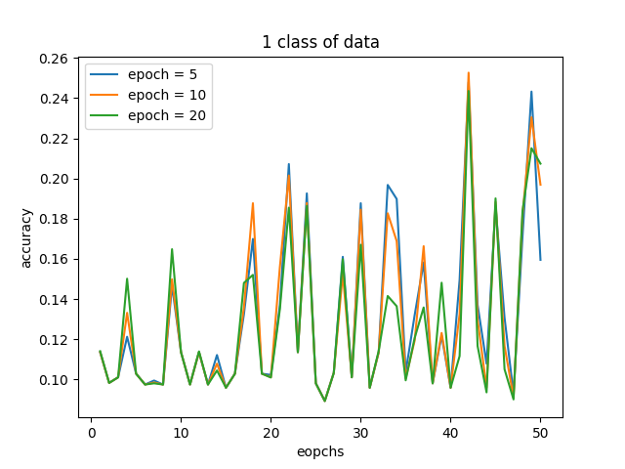
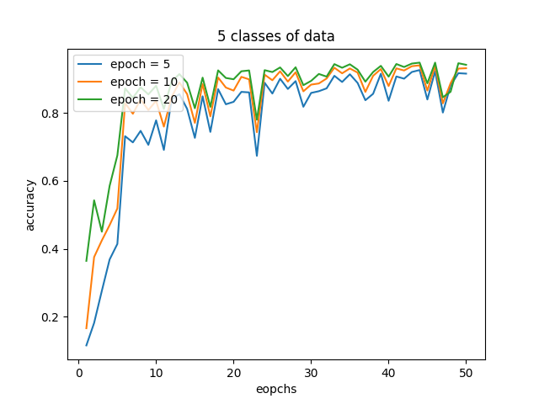
Number of local epochs
More epochs:
1
Slightly better performance if slightly non-IID
2
Nearly no improvement if seriously non-IID
Notes:
So how about adding number of local epochs? We can get slightly better performance if level of non-IID is low, and nearly no improvement if level of non-IID is high.

Slide 30
Number of local epochs
3
Number of local epochs can be low to get similar model performance
4
If number of local epochs is too high, parameters’ divergence may be serious
Notes:
Number of local epochs can be low to get similar model performance without affecting performance of training devices.

Slide 31
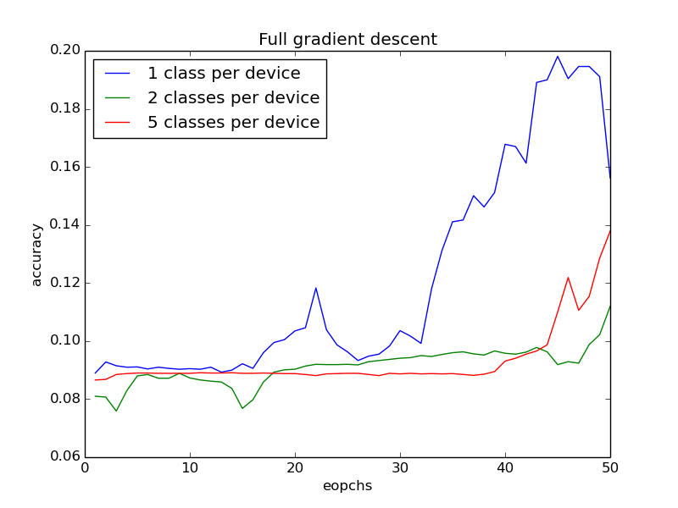
What if local epoch = 1 and full batch size?
1
Shorter computational time
Expectation: more accurate gradients, good for entire dataset
2
3
Reality: poor accuracy
4
Longer training time for a given accuracy
5
Simulate full gradient descent
6
Extreme case: be careful to choose test different combinations of model parameters, e.g. grid search
Notes:
And what if local epoch = 1 and full batch size? It is similar to full gradient descent and computational time is shorter. I expected it may give more accurate gradients which is good for extra dataset. However, as a result, accuracy is poor. It requires longer training time for a given accuracy. This is just an extreme case, but it shows the need to be careful to test different combinations of model parameters, such as grid search.

Slide 32
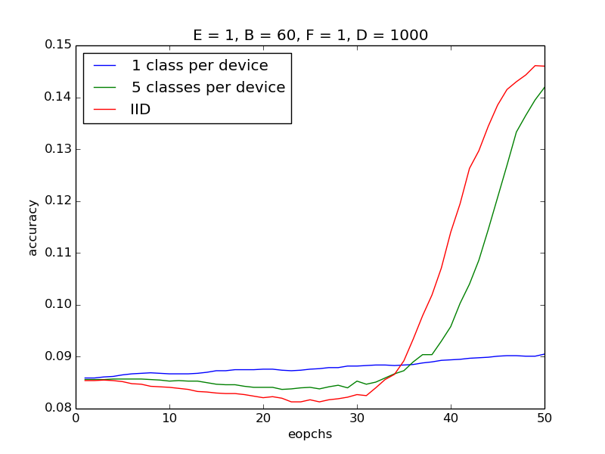
Distributed SGD with FedAvg
1
Local epoch = 1, batch size = 60
2
Select all 1000 devices for training
Distributed SGD: send back gradients to the parameter servers
3
FedAvg: send back models to the parameter servers and do averaging
4
Weakness of FedAvg:
averaging hurts the resulting model, slow convergence speed
5
Notes:
How about simulating distributed SGD with Federated Averaging? In this experiment, there is 1 local epoch per round and batch size is 60. There will be 1000 devices. In distributed Stochastic Gradient Descent, gradients are sent back to the parameter servers, rather than sending back models as in Federated Averaging. The poor performance may be explained by Federated Averaging hurts the resulting model and has slow convergence speed.

Slide 33
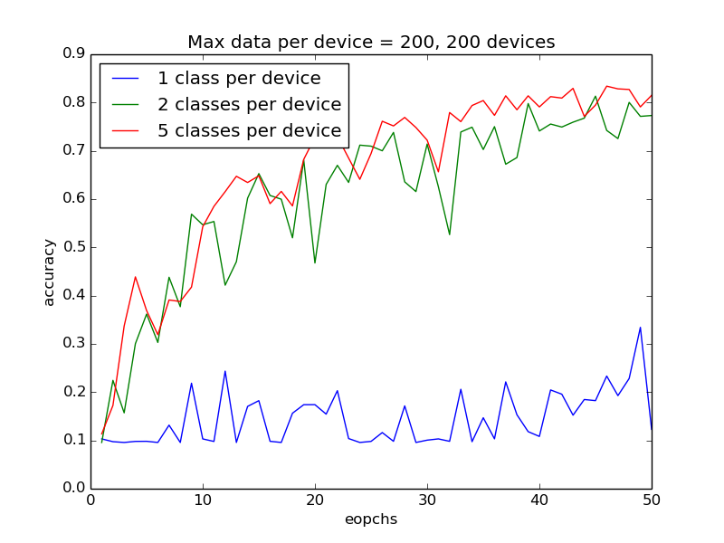
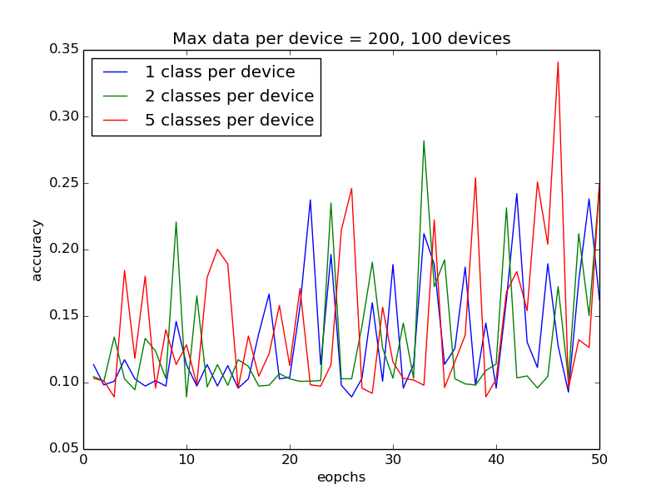
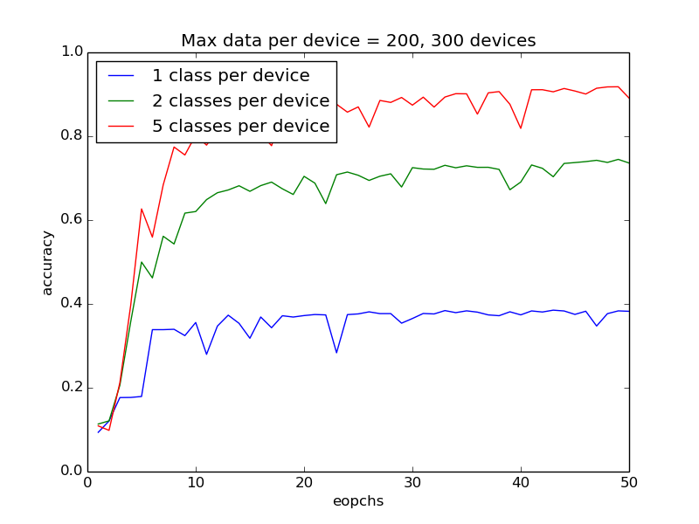
Number of devices
Max amount of data per device = 200,
reduced ~1/3
1
2
Small amount of devices: unstable accuracy
Notes:
So how about changing number of devices for training? In this experiment, max amount of data per device = 200, reduced ~1/3 compared to default setting, It shows that when there is small amount of devices, accuracy is unstable.

Slide 34
Number of devices
Large amount of devices: more stable and higher accuracy
3
Notes:
If there is large amount of devices, we can have more stable and higher accuracy.

Slide 35
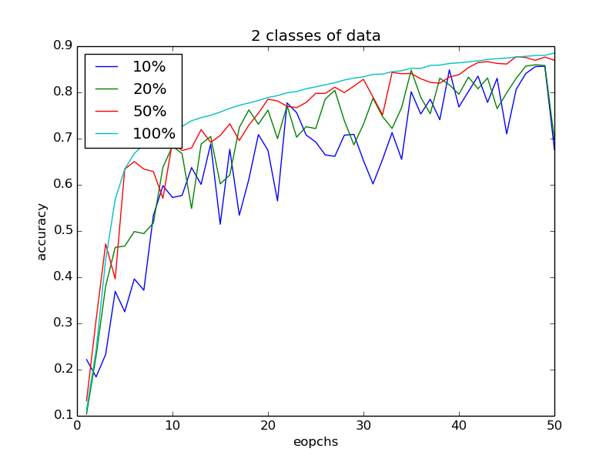
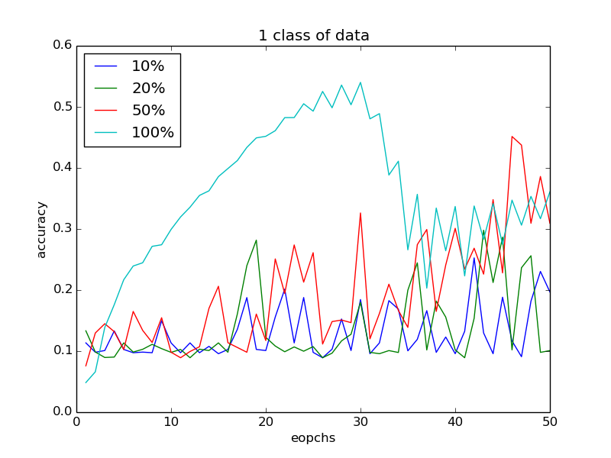
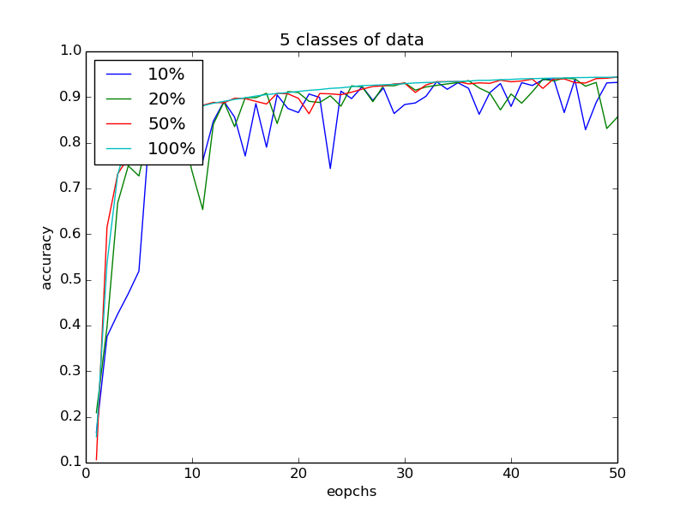
Fraction of devices selected
Selecting more devices may be useful
Data distribution on selected devices is similar to target distribution of the learning model
1
3
High level of participation is generally impossible
2
Notes:
So how about fraction of devices selected? Selecting more devices may be useful if data distribution in highly non-IID, but high level of participation is generally impossible due to variability in network connectivity, power and so on. As Federated Averaging assumes data distribution on devices selected is same as target learning model, the reason why performance increase with more devices selected for training is that data distribution on selected devices is similar to target distribution of the learning model.

Slide 36
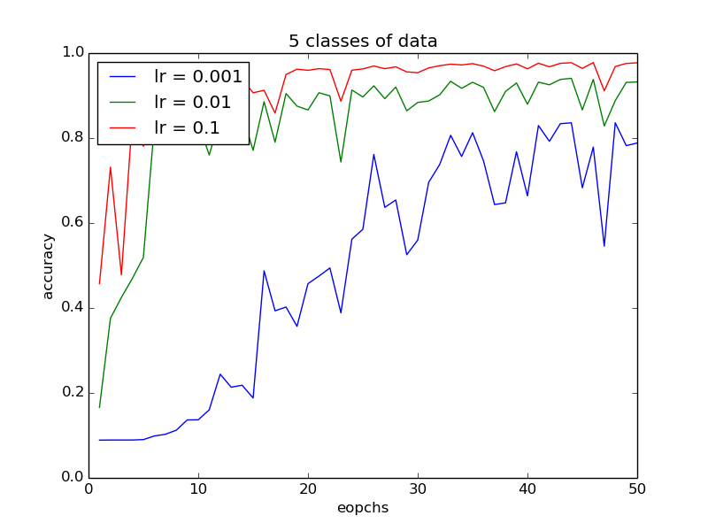
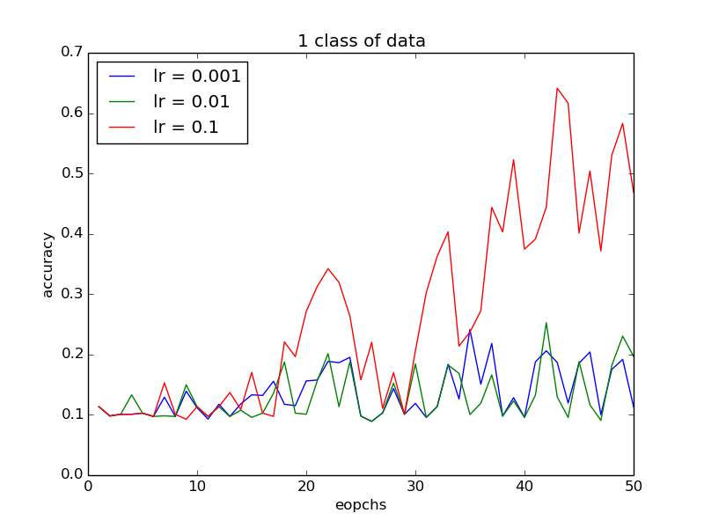
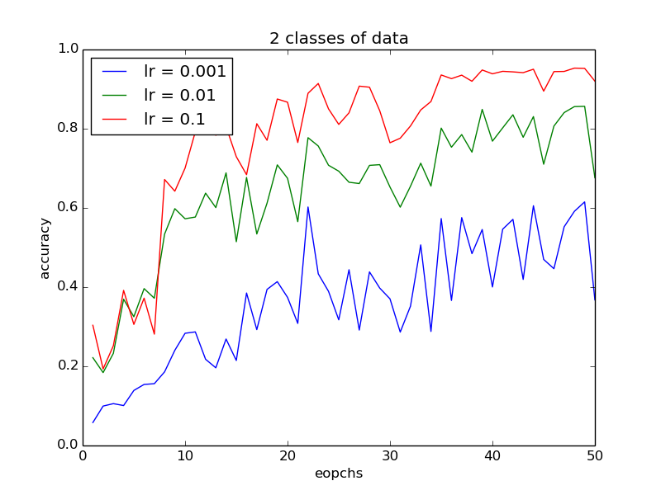
Learning rate
Learning rate is crucial, especially in highly non-IID setting
1
Need to tune by recording loss, 0.1 is optimal in 3 choices
2
3
May use it with learning rate decay
Notes:
So how about learning rate? It is still a crucial training parameter that needs to tune by recording loss. After I did some experiments, it affects performance tremendously especially in highly non-IID setting. In this case, 0.1 is optimal in 3 choices. We may consider using it with decay and other optimization techniques.

Slide 37
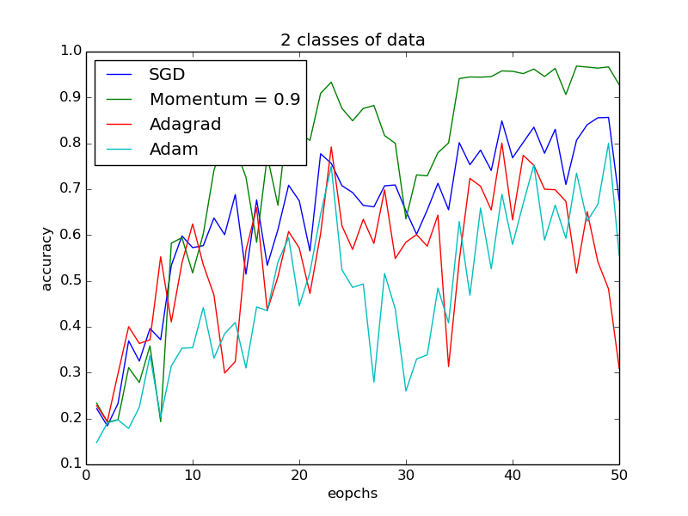
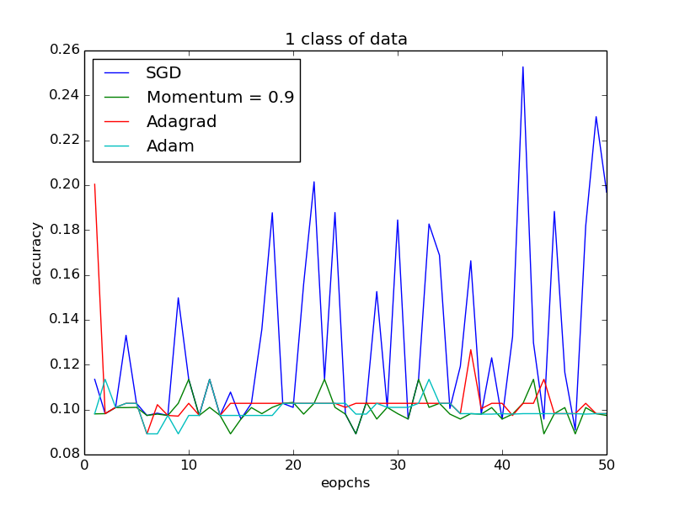
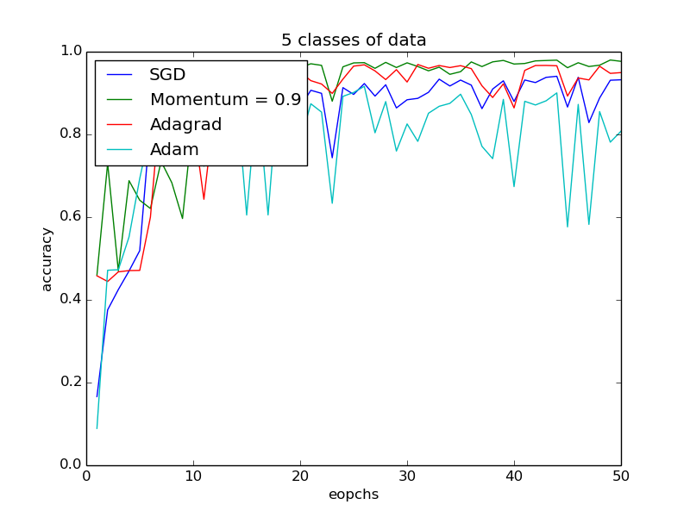
Optimizer
Optimizer is important if not seriously non-IID
1
Adaptive optimizers are sensitive to parameters being averaged, SGD is still advantageous
2
Notes:
So how about optimizer? I tested SGD, SGD with momentum 0.9, Adagrad and Adam. It shows that optimizer is important if not seriously non-IID. Nowadays many people like using adaptive optimizers like Adam because they use adaptive learning rates, which provide faster convergence speed and reduce time of training. However, the results show that, in federated setting, adaptive optimizers may be sensitive to model parameters being averaged. So SGD is still advantageous in performance.

Slide 38
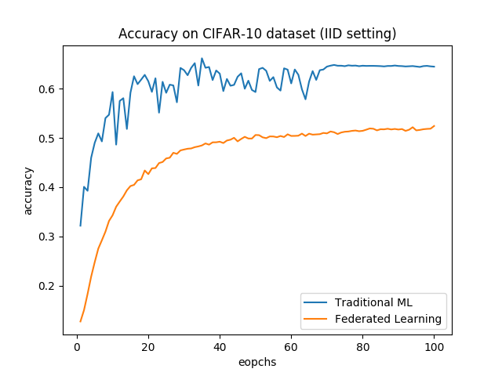
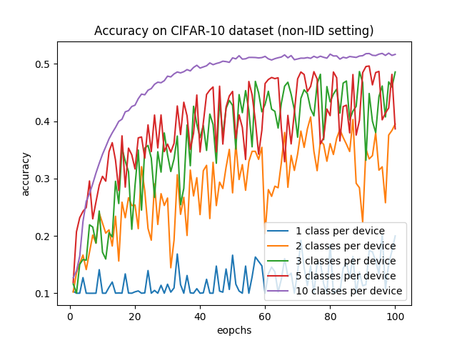
Dataset
CIFAR-10 dataset is slight more complex
1
Also suffers from performance issue
2
Monotonically improving for slightly non-IID distribution, limited by weak 5-layer CNN model
3
Datasets with more classes may have worse results, such as CIFAR-100
4
Notes:
Although I did most of the experiments on MNIST dataset, I would like to test CIFAR-10 dataset to see if performance problem exists. CIFAR-10 dataset is slight more complex than MNIST dataset. As a result, training on it also has performance issue. By observing the statistics, we can see that the performance is monotonically improving for slightly non-IID distribution, but it is limited by the weak 5-layer CNN model. And it is expected datasets with more classes may have worse results, such as CIFAR-100.

Slide 39
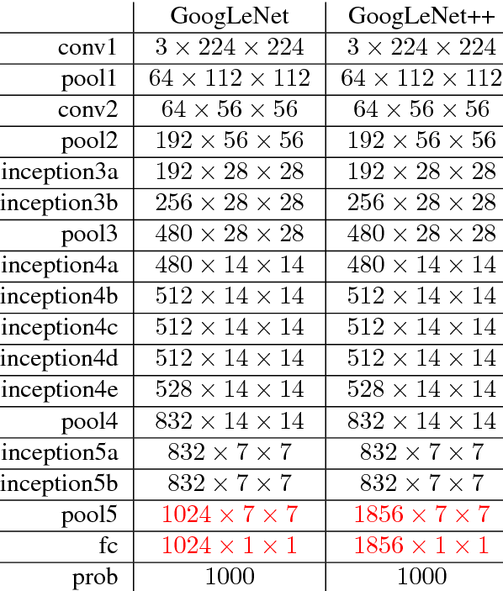
CNN architecture
How about using advanced CNN model like VGG19, GoogLeNet and ResNet152?
1
More accurate, address overfitting by data augmentation and dropout…
2
Variability in network connectivity, hardware and power
3
Extremely long training time and many parameters (e.g. 6.7977 million in GoogLeNet)
4
5
Small number of local epochs
Notes:
So let me talk about CNN architectures. How about using advanced CNN model like VGG19, GoogleNet and ResNet152? They provide higher accuracy, address overfitting by data augmentation and dropout and so on. But can we use these on low-powered devices like smartphone? Well, there is variability in network connectivity, hardware and power. Devices like smartphones and sensors may not be able to train on the model due to extremely long training time and many parameters, which may use up lots of storage space and memory and affect performance of devices. Therefore, small number of local epochs may be used. Using better CNN model may provide slightly better performance but has lots of drawbacks, so it may not be practical in some cases.

Slide 40
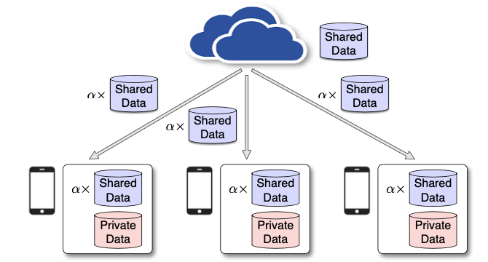
Data sharing technique
1
Distributes a small subset of global data and a warm-up model to the clients at the initialization stage
“Experiments show that accuracy can be increased by ~30% for the CIFAR-10 dataset with only 5% globally shared data.”
Reduces weight divergence and increase accuracy
2
Zhao, Yue, Meng Li, Liangzhen Lai, Naveen Suda, Damon Civin, and Vikas Chandra. "Federated Learning with Non-IID Data." 2018.
3
May violate privacy (sending data to others)
Notes:
So, to tackle the problem of performance drop, last year some scholars used data sharing technique with Federated Averaging. They stated in the paper that “experiments show that accuracy can be increased by ~30% for the CIFAR-10 dataset with only 5% globally shared data”. The server distributes a small subset of global data and a warm-up model to the clients at the initialization stage. The principle is that devices have more than 1 class of data, so diversity of data increase and data on each device is less non-IID. Therefore, weight divergence can be reduced and performance can be better. Although shared data may be collected before the initialization stage of Federated Learning, it may violate previous users’ privacy as the server sends their data to other users.

Slide 41
Data sharing technique
Results similar to x% non-IID
2
20% data on device is shared IID data, ~40% accuracy boost
1
“Experiments show that accuracy can be increased by ~30% for the CIFAR-10 dataset with only 5% globally shared data.”
Notes:
I mentioned the performance on non-IID data in terms of percentage earlier. It is similar to this technique. That is, if there is 80% non-IID, 20% data on device is shared IID data, then overall accuracy can boost by about 40%. That’s a simple and useful strategy.

Slide 42
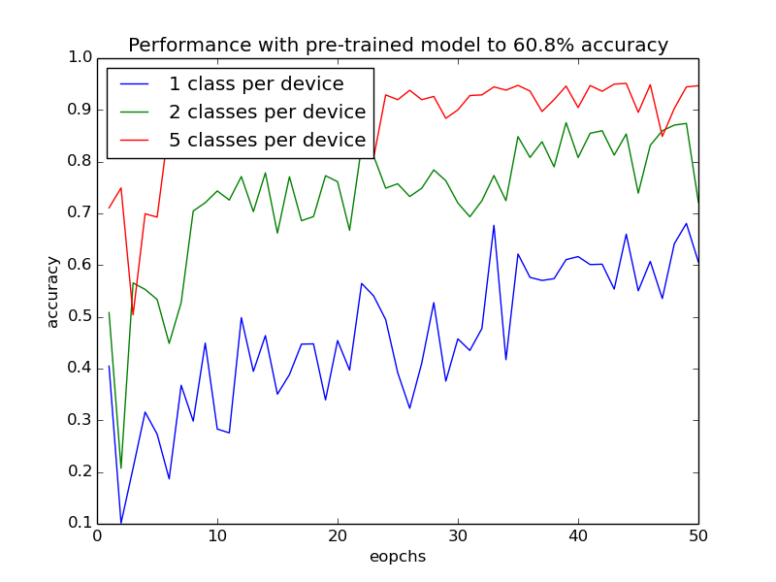
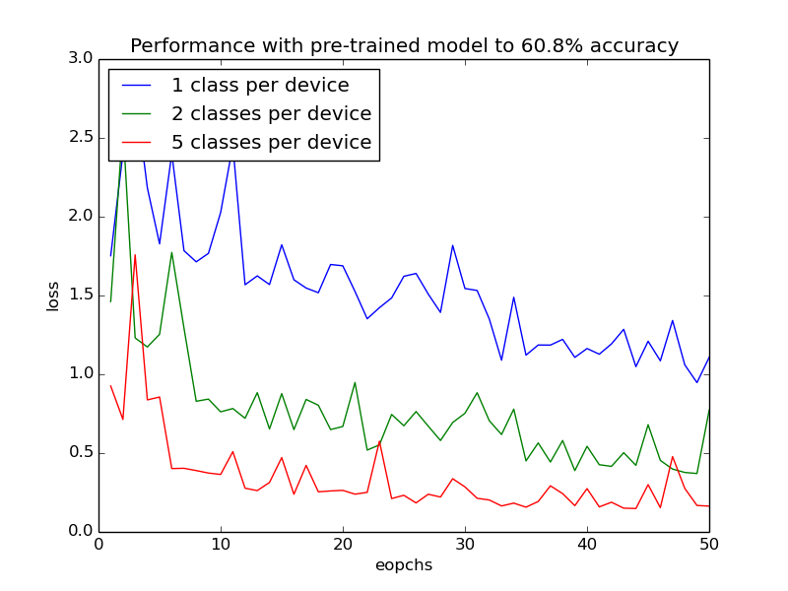
Pre-trained model with 60.8% accuracy
Can transfer learning work?
1
1 class per device: 20% -> 60% accuracy, 2/5 classes no difference
2
3
Seems useful but not really, can only remain ~60% accuracy, accuracy may drop over time
Notes:
Their techniques gave me some inspirations. That is, can transfer learning solve the problem? I used a pre-trained model with accuracy about 60.8% for Federated Learning. As a result, accuracy of 1 class per device boosted from ~20% to ~60%. There is nearly no difference for 2 and 5 classes per device. This strategy looks useful at first glance, but not really, because 1 class per device can only achieve ~60% accuracy, and accuracy may drop over time, due to the properties of Federated Averaging.

Slide 43
04
PART
Summary
Notes:
So let me summarize what I have found.

Slide 44
Summary
1
Reasons for poor accuracy:
Bad training setting, non-IID data distribution and bad FL algorithm
2
Tuning training parameters is important in traditional ML and FL
3
Even with good model, training parameters, optimizer cannot solve the problem, need alternative FL algorithms (e.g. FedCurv, FedProx)
Notes:
There are lots of reasons for poor accuracy: bad training setting, non-IID data distribution, and bad Federated Learning algorithm, which is the most important one. Tuning training parameters and good training setting is important in traditional Machine Learning and Federated Learning. Even with good model, training parameters, optimizer, you cannot solve the problem, you need to use alternative FL algorithms, like FedCurv and FedProx.

Slide 45
Limitations
1
Used data-driven optimization because the goal is to describe the relationship, real-world scenarios are more complex
Did not try complex datasets because it is time-consuming
2
3
Did not consider communication constraints but lower accuracy is expected with optimizations
4
Explanations may be empirical, will back up them with research in report
5
Computer hardware, time, ML knowledge…
Notes:
There are some limitations in this project. First, when testing different training parameters, I used data-driven optimization because the goal is to describe the relationship, real-world scenarios are more complex and may require cross validation. I did not try complex datasets because my computer hardware is poor and it is time-consuming to train model on datasets like ImageNet. I did not consider communication constraints but lower accuracy is expected with communication optimizations like random mask and probabilistic quantization. And explanations may be empirical, I will back up them with research in report. Finally, my computer hardware is poor and I spent most of the time learning basics of machine learning and I am not able to test some advanced techniques.

Slide 46
Thanks!
Source code will be available at:
https://github.com/wongngaisum/federated-learning-noniid
Notes:
Thanks for listening and you can see my source code at https://github.com/wongngaisum/federated-learning-noniid later.

